Slide 1
Executive Summary Introduction
Flying on airplanes is safer than driving in vehicles
Data is based on the years 2000 through 2014
Airlines fly millions of kilometers per a year without any major incidents
Most airlines that had fatalities were outside of the United States
Even though the fatal incidents are low, it is based on the number of passengers the aircraft can carry
Major U.S. airline revenue has not suffered due to fatalities, but revenue has suffered due to 9/11 World Trade Center attacks and the 2008 Financial crisis
Vehicles usually carry a lot less passengers than aircrafts do so there will be less fatalities per a vehicle in the U.S.
Vehicles travel millions of miles every year on American roads so there will be a lot more fatal accidents that occur and can add up

Slide 2
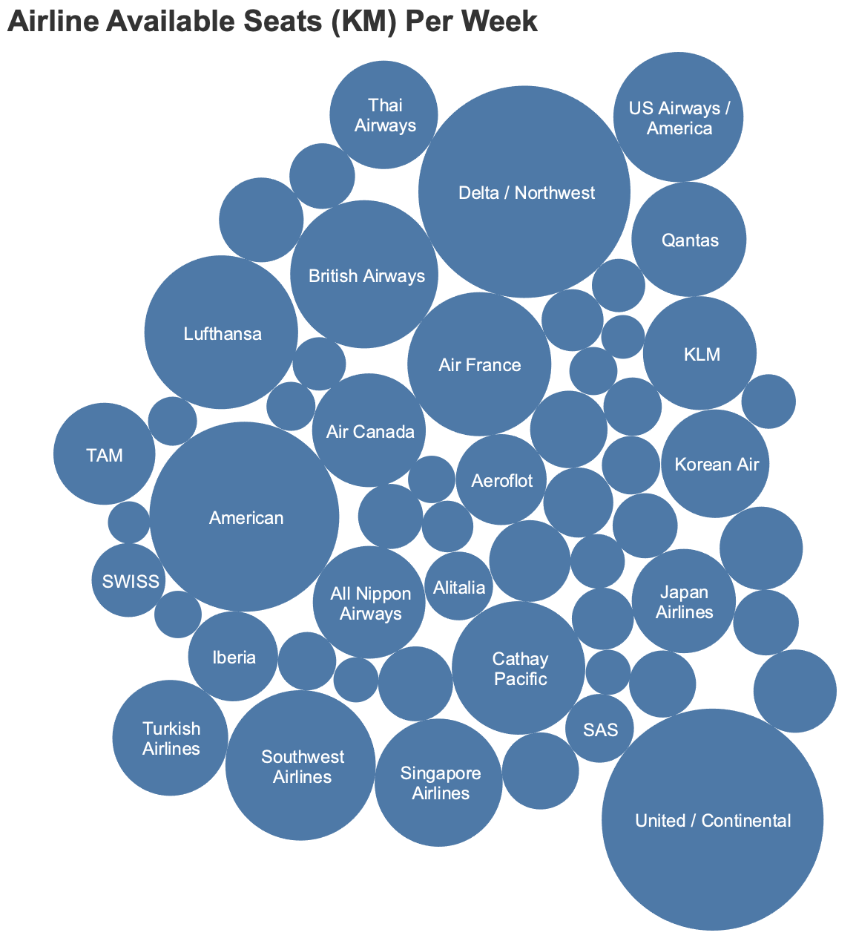
Executive Summary
Airline Available Seats Kilometers Per a Week
Delta/Northwest, United/Continental, American have the most kilometers traveled per a week compared to other airlines
Crash Stats & Reports

Slide 3
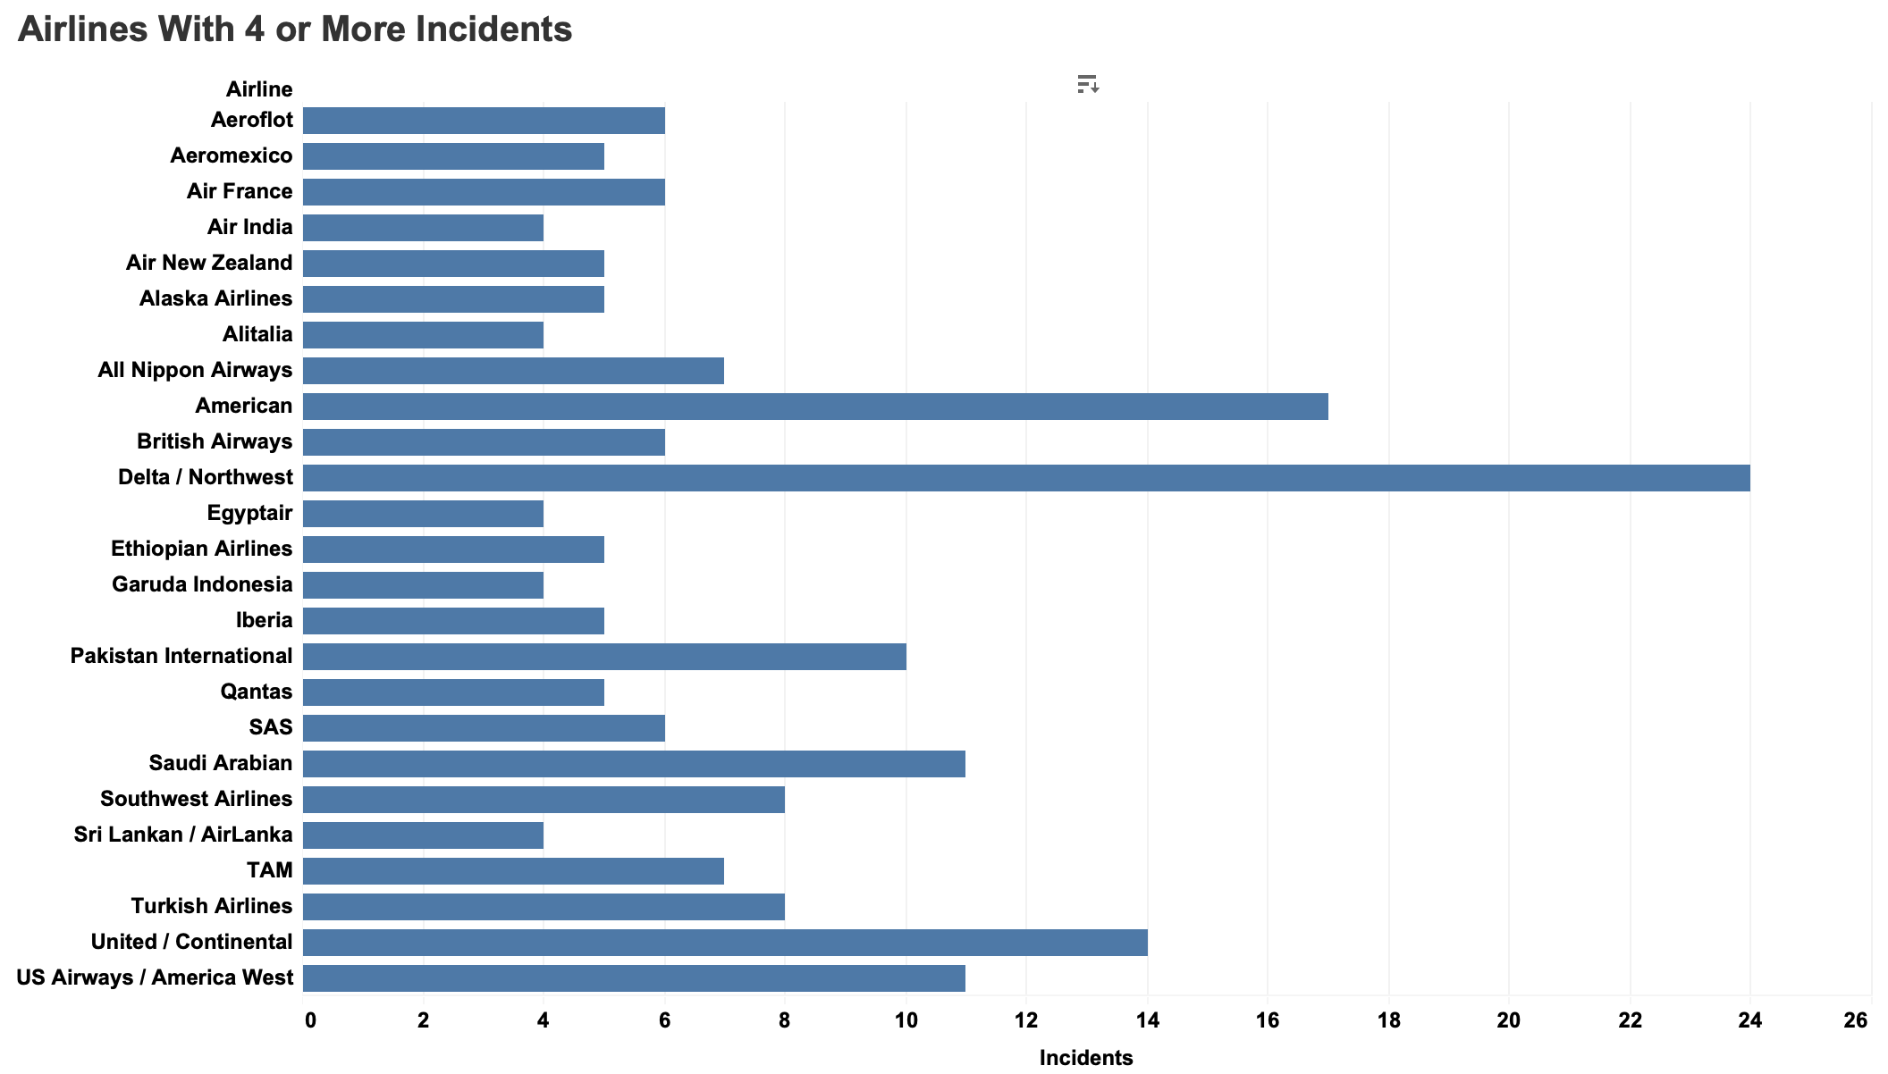
Executive Summary
Airlines With 4 or more Incidents
Crash Stats & Reports

Slide 4
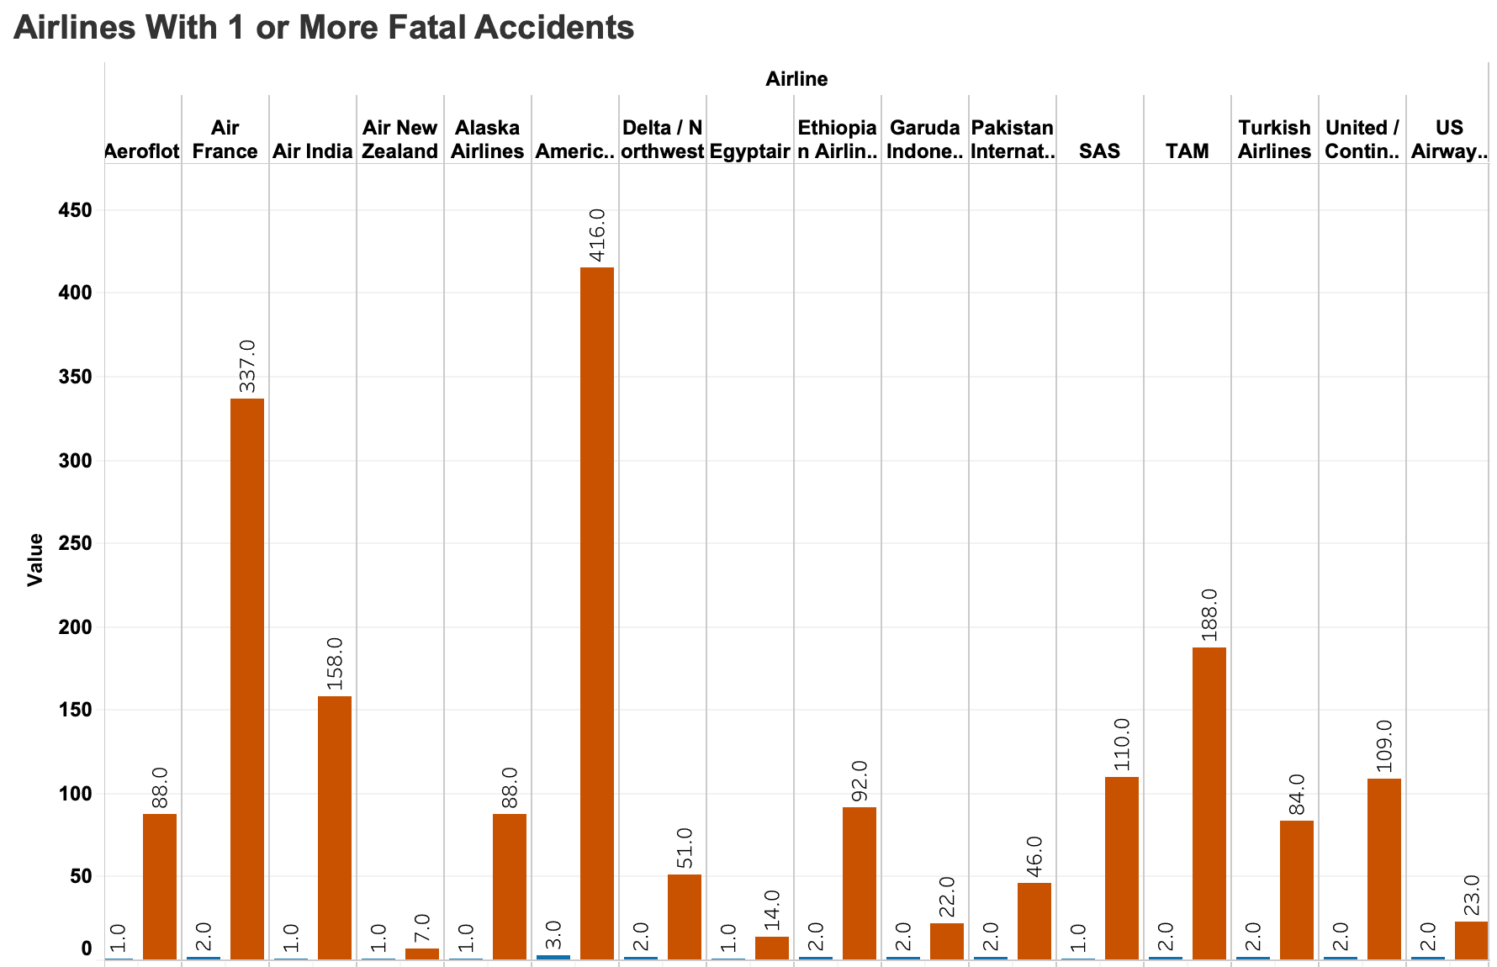
Executive Summary
Airlines With 1 or More Fatal Accidents
Fatal accidents are very low compared to the number of incidents
Depending on the size of the plane, depends on how many fatalities there are
Most of the fatal incidents were on foreign airlines
Crash Stats & Reports

Slide 5
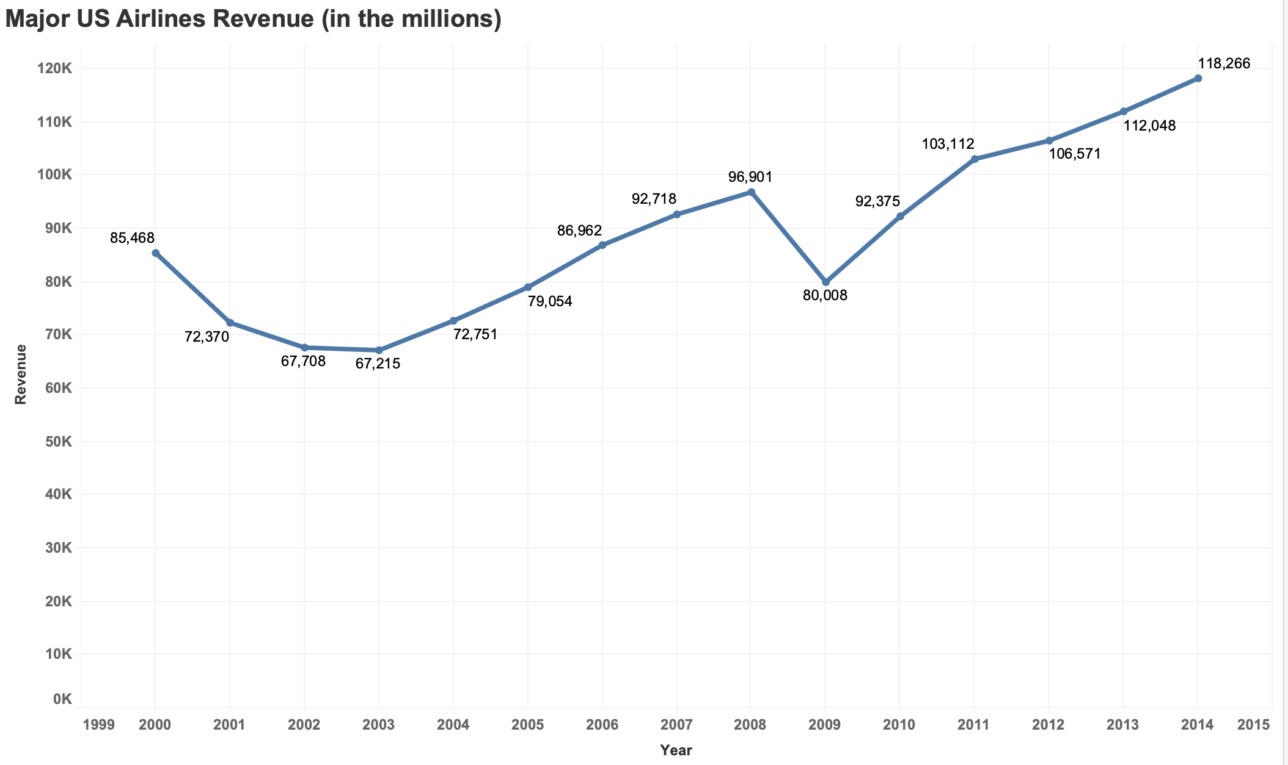
Executive Summary
U.S. Airlines were not affected by plane crashes
2001 – 9/11 World Trade Center Attack – Took a while for airline travel to recover
2008 – Financial crisis started
Passenger Revenue – Total System Operations

Slide 6
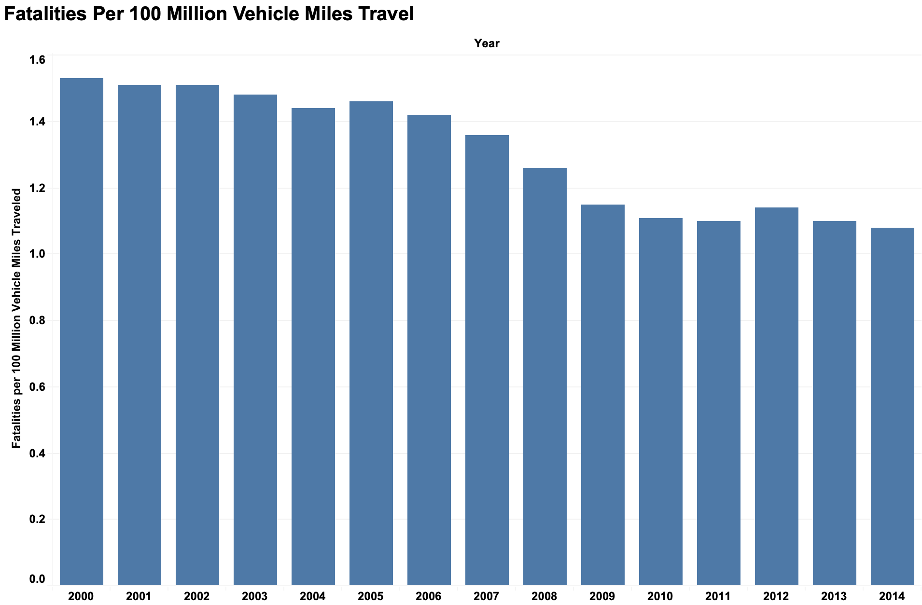
Executive Summary
U.S. Vehicle Fatalities Per 100 Million Vehicle Miles
The vehicle fatalities are low with all the miles that are driven for each year
Fatalities start to go mostly down in 2005
National Statistics

Slide 7
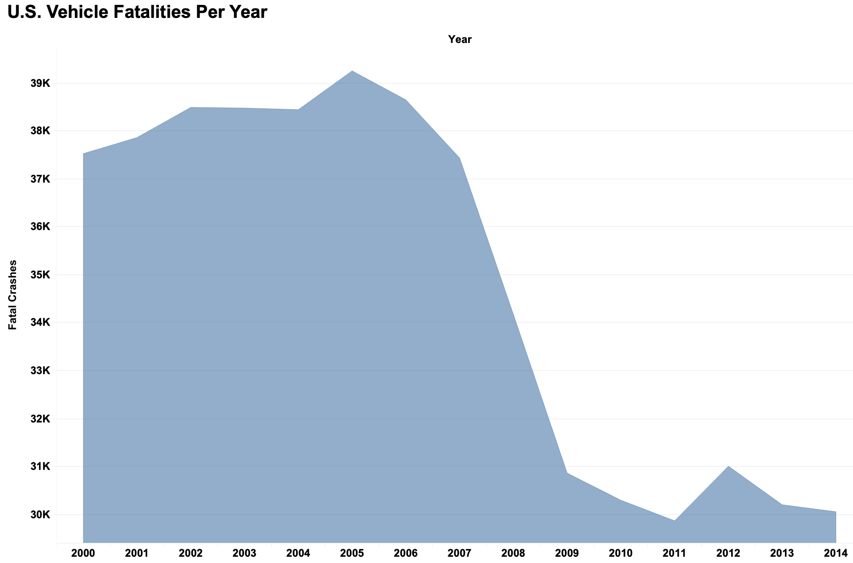
Executive Summary
U.S. Vehicle Fatalities
There are many vehicles on roads but there will be fewer fatalities per a car
Based on the data, fatalities started to decrease in 2006
National Statistics

Slide 8
Executive Summary Conclusion
Flying on airplanes is safer than driving in vehicles
Data is based on the years 2000 through 2014
Airlines fly millions of kilometers per a year without any major incidents
Most airlines that had fatalities were outside of the United States
Even though the fatal incidents are low, it is based on the number of passengers the aircraft can carry
Major U.S. airline revenue has not suffered due to fatalities, but revenue has suffered due to 9/11 World Trade Center attacks and the 2008 Financial crisis
Vehicles usually carry a lot less passengers than aircrafts do so there will be less fatalities per a vehicle in the U.S.
Vehicles travel millions of miles every year on American roads so there will be a lot more fatal accidents that occur and can add up

